Slide 1
Revision Techniques

Slide 2
The Statistics
66% material is forgotten after 7 days
88% material is forgotten after 6 weeks
Reading notes and text books leads to a mere 10% retention ☹

Slide 3
Be Organised
Where?
Sit at a desk – somewhere designed for study
What?
Make task specific & realistic
How?
Like > Less favoured > Like
When?
Alert – times of the day...
Why?
Review
Filling System
Notes
Less is more

Slide 4
Make a timetable
Know your topics and subtopics
Plan when you are going to study
Use short bursts
Timetable in Exercise

Slide 5
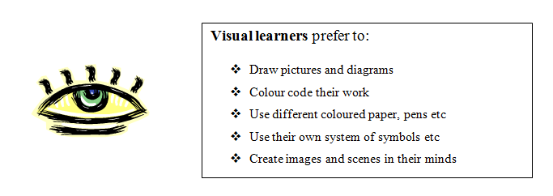
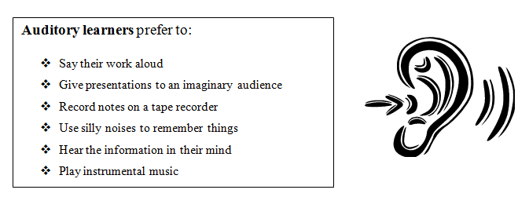
Know your Learner

Slide 6
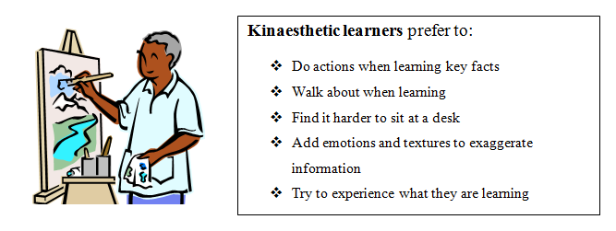
If you know what type of learner you are, you can then tailor your revision to your needs...

Slide 7
Revision Activities
Mind-maps
Key words – post-its
Flash Cards
Podcasts
Family and Friends Test
Highlight
Chant/Rap
Exam Questions and Mark Scheme
Write your own Q’s
Mnemonics

Slide 8
After a one hour memorising session:
10 minutes later revise the topic for 10 minutes
1 day later revise the topic for 5 minutes
1 week later revise the topic for 2-5 minutes
1 month later revise the topic for 2-5 minutes
Before exams revise the topic as required.
Each time knowledge is reinforced; it enters deeper into the long-term memory and becomes more stable.

Slide 9
Word Document
I have found a really good document on the internet.
It is almost 50 pages long, but has some really good revising, exam prep and exam technique.
I will email it to you and put it on the VLE

Slide 10
Task
You are going to use some of the revision techniques you have learnt today to revise a sub-topic in B1...
GO!!

